Slide 1
Investigation of Calorimetry burned in food using Image Processing and IoT
Project Guide : Project Coordinator : Team Members : Mrs. P .Kamakshi Thai Mrs. G. Sri Sudha P. Sushanth 21AG1A6647
G. Uday 21AG1A6622
B. Suresh 21AG1A6607

Slide 2
Abstract
The study of calorimetry involves measuring the amount of heat released or absorbed during chemical reactions, physical changes, or phase transitions. In the context of food science, calorimetry is crucial for determining the caloric content of food items. Traditional methods of calorimetric analysis can be time- consuming and require significant manual intervention. The integration of image processing and Internet of Things (IoT) technologies offers a novel approach to automate and enhance the accuracy of calorimetric measurements in food.
Keywords: YOLO, Calorie Measurement, Pre-processing and Feature Extraction, IoT Integration, Data Analysis.

Slide 3
LITERATURE SURVEY
AUTHOR(S) | METHOD/TECHNIQUE | DETAILS | ACCURACY/RESULT
Gabor Channel | Division by Gabor filter and classification using SVM | Gabor filter used for texture analysis to detect specific frequency content in images. Food portion estimation used thumb for size comparison to compute dietary values from nutrition tables. | Accuracy increased to about 86%.
Turmchokk Sam et al. | Food recognition and calorie estimation using a combination of dietary data, temperature, and brightness levels with CCD camera | Utilized thermal and CCD camera data for enhanced food recognition and calorie estimation, yielding better accuracy compared to traditional methods. | More accurate results than conventional methods.

Slide 4
He et al. (DietCam) | Multi-view, multi-part SVM for ingredient recognition and food classification | System first recognizes food ingredients using texture and component models, then classifies food items using a multi-view multi-part SVM. DietCam was tested on over 15,000 images covering 55 different food classes. | High accuracy for complex food items with multiple components.
M. A. Subhietal | Traditional methods and neural networks for food recognition and nutrient estimation | Reviewed conventional techniques and neural networks (e.g., SVM, MLP) for food recognition. Highlighted the challenge of accurately estimating food volume, with MATLAB used to implement SVM and MLP for more accurate results. | Successfully applied SVM and MLP for positive outcomes.
Lifson & McClintock | Doubly Labeled Water (DLW) technique for energy expenditure estimation | Developed in the mid-1950s, DLW is used for estimating energy consumption and dietary intake by measuring isotopes in body water | Widely used for energy expenditure studies.

Slide 5





Methodology
Data Collection
Collected from Kaggle.
Data Splitting
80% for training, 20% for testing.
Preprocessing
Image cleaning and enhancement.
Feature Extraction
Extracting relevant features.

Slide 6
Existing System
Current systems for food calorie estimation rely on a variety of image processing techniques to classify food items and estimate their nutritional content. Several approaches have been proposed to improve accuracy and usability. One of the primary methods uses Gabor Filters and Support Vector Machines (SVM). The Gabor filter analyzes surface textures of the food item, while SVM classifies it based on patterns from training data. However, this system requires users to place a reference object, such as a thumb, near the food to help the algorithm estimate the portion size, leading to an accuracy of approximately 86%.
Another approach involves using CCD (Charge-Coupled Device) and thermal cameras, capturing brightness levels and temperature data to enhance food recognition. This system, while more accurate than traditional methods, is complex due to its reliance on additional hardware components. Systems such as DietCam, which utilize a multi-view multi-part SVM, improve classification accuracy by focusing on ingredient recognition and food categorization. However, the challenge of intra-class variations—differences within the same food category—still remains a significant obstacle in food recognition.

Slide 7
Disadvantages of Existing System
User Dependency: Systems using Gabor filters and SVM require manual intervention, such as placing a thumb near the food for portion size estimation.
Hardware Dependency: Systems employing CCD and thermal cameras are dependent on specialized hardware, making them expensive and difficult to implement widely.
Volume Estimation: Accurately estimating food volume continues to be a challenge, as many methods still rely on manual input or multiple views of the food, reducing overall accuracy and usability.

Slide 8
Proposed System
The proposed system uses YOLO (You Only Look Once) for automatic food calorie estimation through image processing. This system eliminates the need for user intervention or specialized hardware by leveraging advanced object detection techniques. YOLO is trained on a large dataset of food images, enabling it to detect and classify food items accurately in a single forward pass. Features such as texture, size, and shape are extracted, allowing the system to estimate calories efficiently without the need for reference objects or multi-view inputs.

Slide 9
Advantages of the Proposed System
Fully Automated: The YOLO-based system eliminates the need for manual inputs such as thumb placement or multiple photos, enhancing user convenience.
Higher Accuracy: Leveraging YOLO’s advanced object detection capabilities, the system integrates features like texture, shape, and size to achieve improved food recognition accuracy and calorie estimation compared to traditional methods.
Scalability: The proposed system can be seamlessly deployed as a web or mobile application, making it accessible to a broader audience without requiring specialized hardware like CCD or thermal cameras.

Slide 10
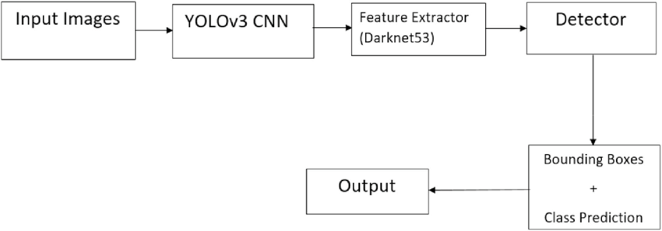
Proposed System

Slide 11
Hardware Requirements:
IoT Camera: For capturing food images automatically.
Microcontroller/Processor: Devices like Raspberry Pi or Arduino to manage image capture and transmission.
Connectivity Module: Wi-Fi or Bluetooth for real-time image transmission to the server.
Power Supply: Stable power for IoT devices and connectivity modules.
Software Requirements:
YOLO Model: Pre-trained YOLO model for food detection, recognition, and calorie estimation.
IoT Communication Protocol: MQTT/HTTP for data transmission between IoT devices and backend.
Backend System: Web application (e.g., Python with Django/Flask) for processing images and returning calorie results.
Frontend Interface: Web/mobile app for user interaction, built using HTML, CSS, JavaScript (React/Angular).
Database: To store food images, calorie data, and user profiles (MySQL/PostgreSQL).
USDA REST API Integration: Instead of a traditional database, the system integrates with the USDA REST API to retrieve food nutrition and calorie data dynamically.

Slide 12
Modules of the System
Image Collection Module:
Captures food images using IoT devices for processing.
Preprocessing Module:
Processes and extracts features (texture, shape, size) from images.
Classification Module:
Uses YOLO to classify food items and identify nutritional values.
Calorie Estimation Module:
Estimates the caloric content based on classified food items.

Slide 13
Algorithm
YOLO (You Only Look Once):
Purpose: YOLO is used for real-time food detection, feature extraction, and classification directly from food images.
Key Features: Extracts features such as texture, size, and shape to classify food items and estimate calorie values.
Why YOLO?: YOLO excels in object detection tasks due to its ability to process images in a single pass, making it highly efficient and suitable for real-time food image analysis.
IoT Communication Protocol:
MQTT/HTTP: Lightweight protocols for communication between IoT devices and the backend, ensuring real-time transmission of food images for analysis.
Preprocessing Algorithms:
Image Preprocessing: Techniques like resizing, normalization, and data augmentation are applied to the images before feeding them into the CNN model for improved recognition accuracy. Tools like OpenCV are used for preprocessing.

Slide 14
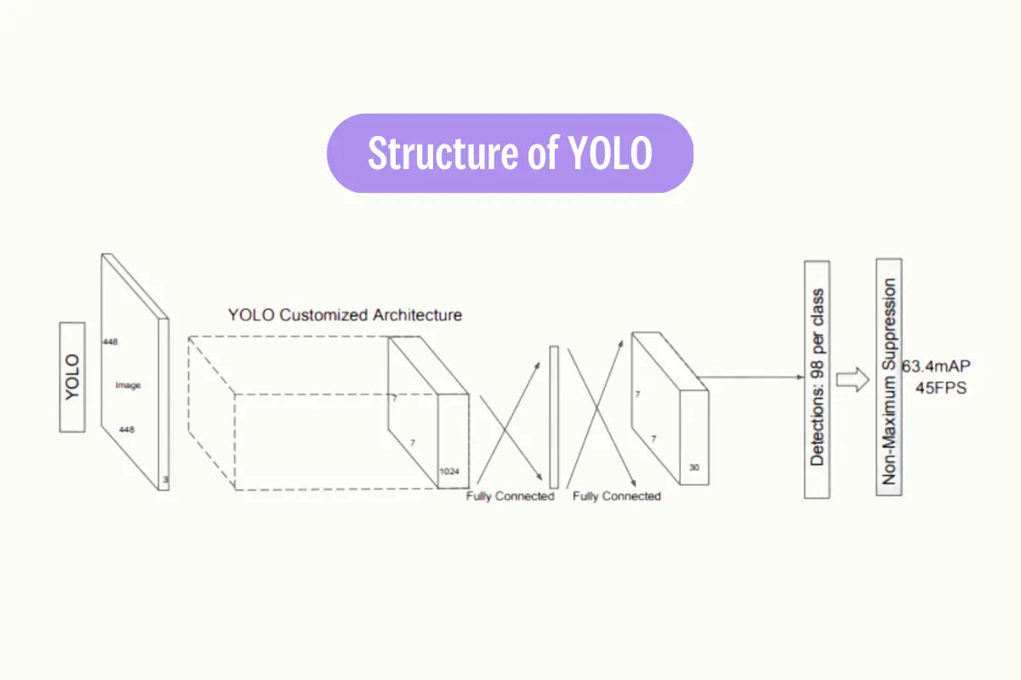
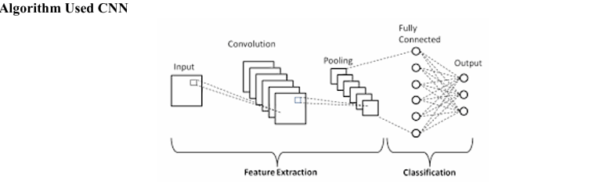

Slide 15
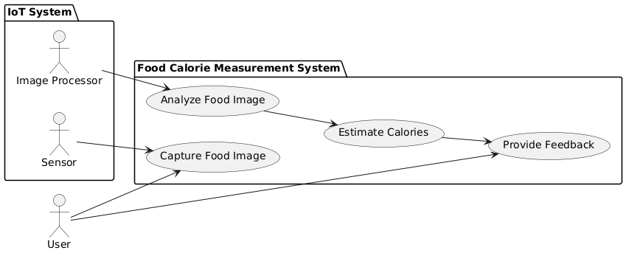
Design
Use Case Diagram

Slide 16
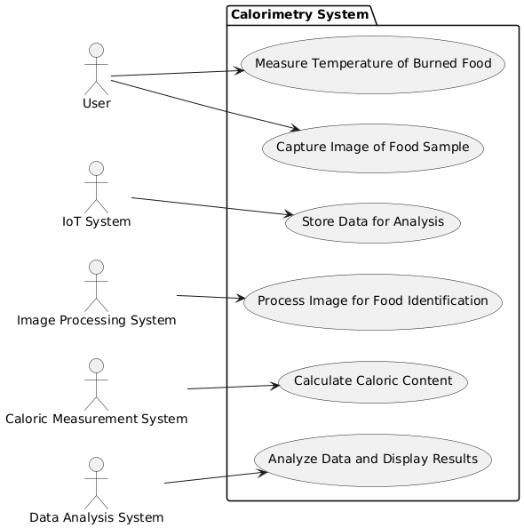
Activity Diagram

Slide 17
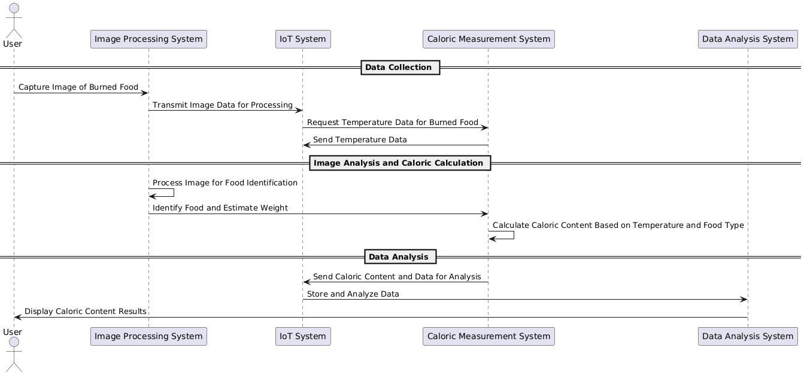
Sequence Diagram

Slide 18
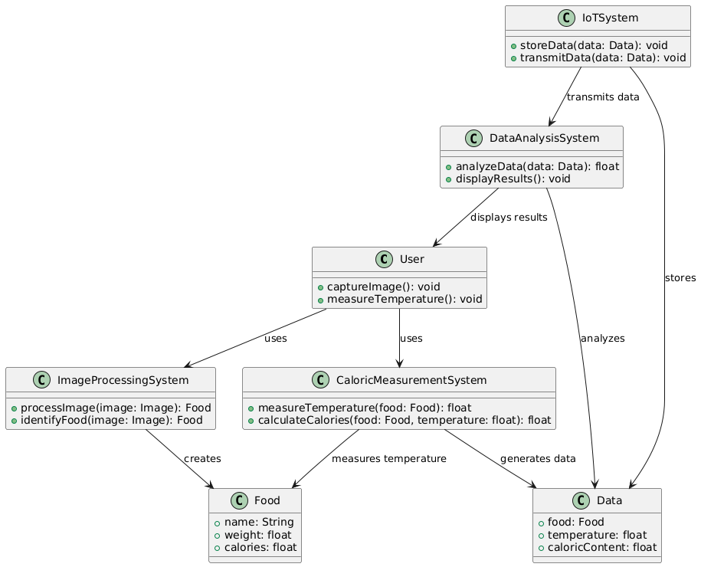
Class Diagram

Slide 19
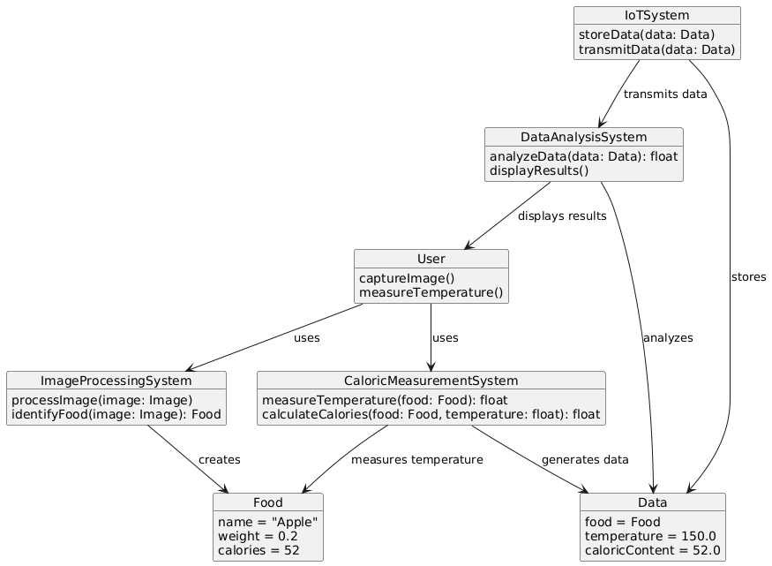
Object Diagram

Slide 20
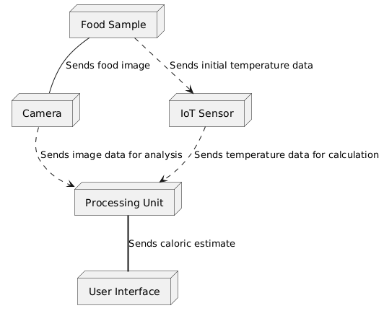
Deployment Diagram

Slide 21
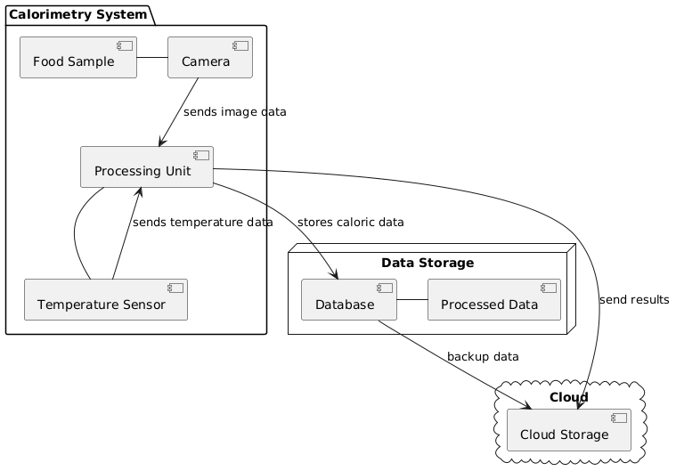
Component Diagram

Slide 22
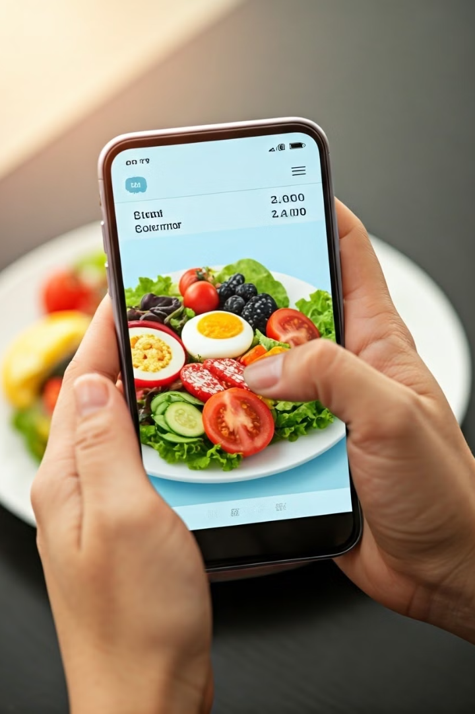
Conclusion
This research demonstrates the potential of image processing for food recognition and calorie estimation.

Slide 23


